Slide 1
Lecture 9: Red-black tree
Keren Zhu
kerenzhu@cse.cuhk.edu.hk

Slide 2
Balanced binary search tree
The key problem is on how to balance a BST so that its height is under control
Too expensive balancing will cost run time overhead on insertion and deletion
Tons of research and data structures have been proposed
Red-black tree is among the most famous ones
Usually the implementation of std::set and std::map
In this class, we don’t require you to memorize the insert and delete procedures
When given a real case, you shall be able to find the procedures

Slide 3
Rules for RB trees
Rule 1: Every node is either red or black
Rule 2: The root is black
Rule 3: Every leaf (NIL) is black
Rule 4: If a node is red, then both its children are black
Rule 5: For each node, all simple path from the node to descendant leaves contains the same number of black nodes
Rule 4 and rule 5 triggers the dynamic balancing

Slide 4
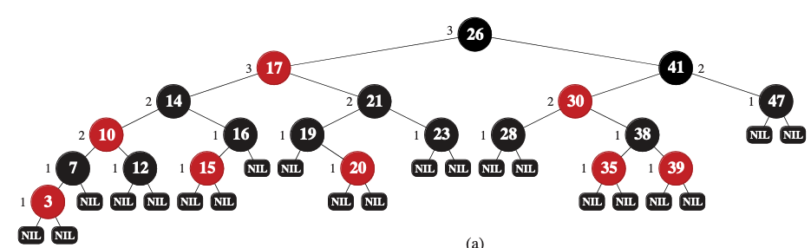
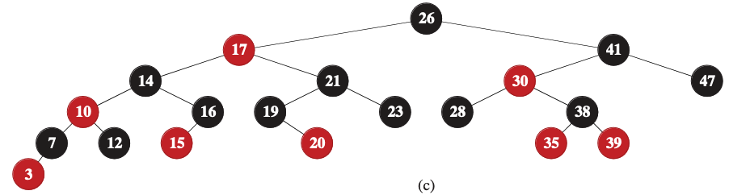
Omit the NIL nodes for simplicity
All the leaf nodes are NIL. In illustration and implementation, we can simplify it: in homework and we can omit NIL in drawing, but we need to remember they are still there

Slide 5
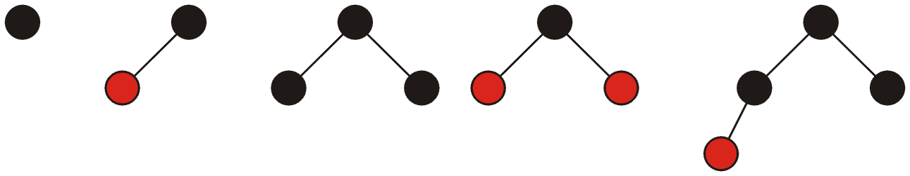
Red-Black Trees
All red-black trees with 1, 2, 3, and 4 nodes:

Slide 6
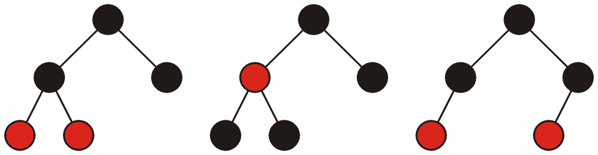
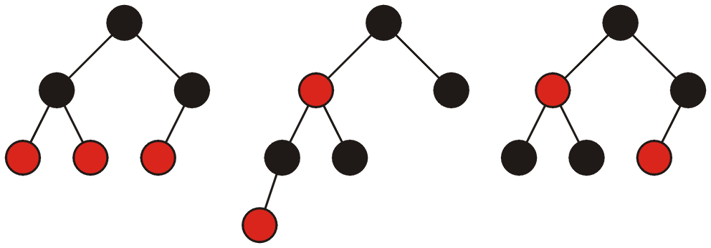
Red-Black Trees
All red-black trees with 5 and 6 nodes:

Slide 7
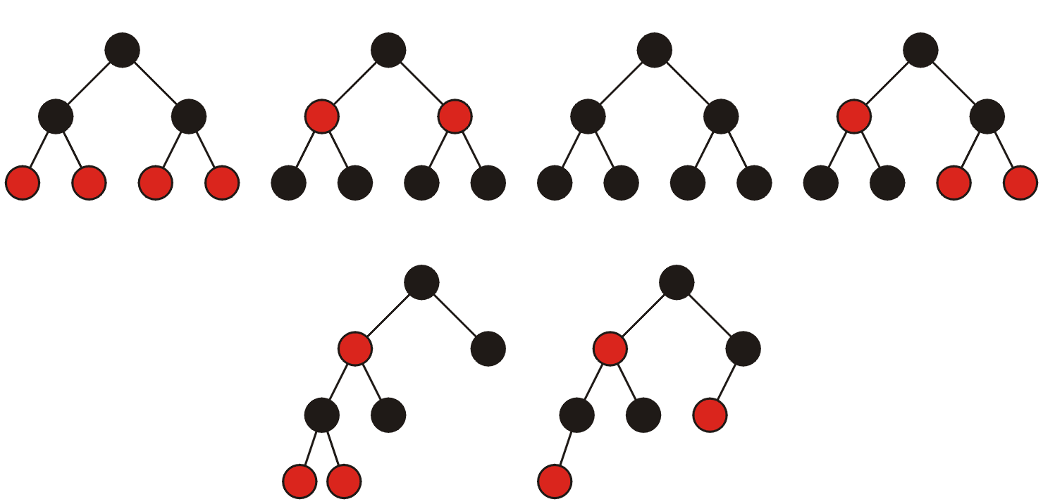
Red-Black Trees
All red-black trees with seven nodes—most are shallow:

Slide 8
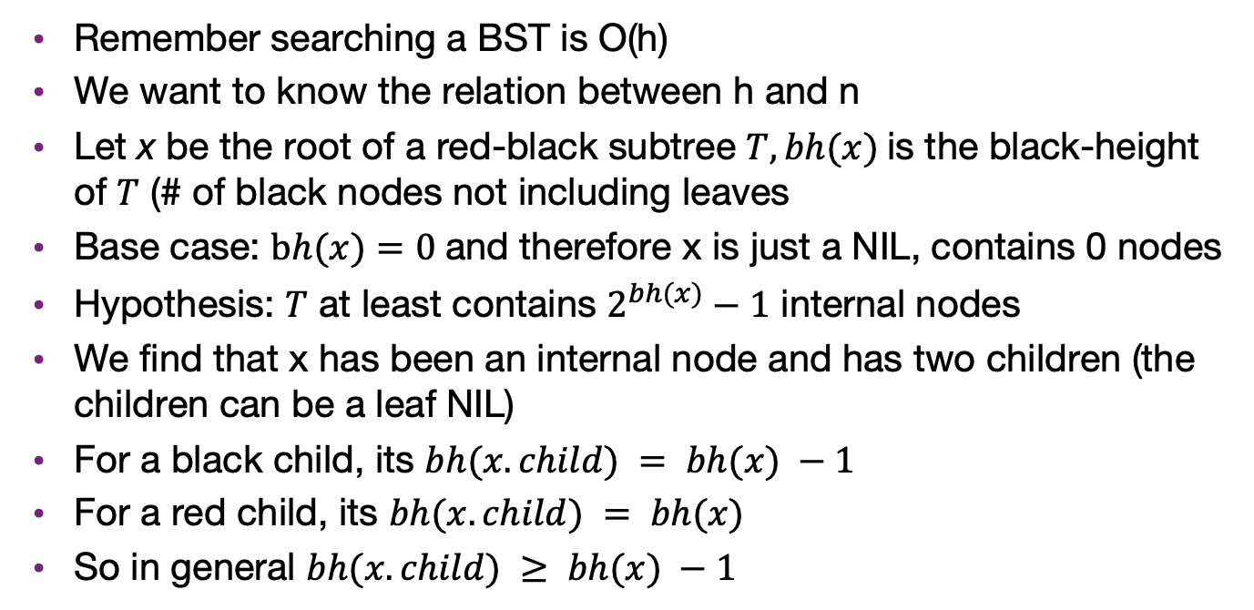
What is the search complexity
Remember searching a BST is O(h)
We want to know the relation between h and n
Let x be the root of a red-black subtree $T, bh(x)$is the black-height of $T$ (# of black nodes not including leaves
Base case: $bh(x)=0$and therefore x is just a NIL, contains 0 nodes
Hypothesis: $T$ at least contains $2^{bh(x)}−1$ internal nodes
We find that x has been an internal node and has two children (the children can be a leaf NIL)
For a black child, its $bh(x.child) = bh(x) −1$
For a red child, its $bh(x.child) = bh(x)$
So in general $bh(x.child) ≥ bh(x) −1$

Slide 9
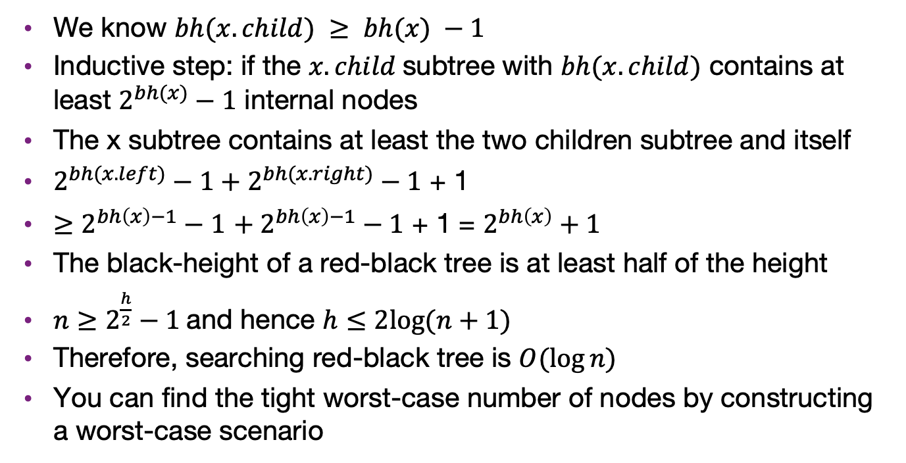
What is the search complexity
We know $bh(x.child) ≥ bh(x) −1$
Inductive step: if the $x.child$subtree with $bh(x.child)$ contains at least $2^{bh(x)}−1$ internal nodes
The x subtree contains at least the two children subtree and itself
$2^{bh(x.left)}−1+2^{bh(x.right)}−1$ + 1
$≥$ $2^{bh\left(x\right)−1}−1$ ${+ 2}^{bh\left(x\right)−1}−1$ + 1 = $2^{bh\left(x\right)}+1$
The black-height of a red-black tree is at least half of the height
$n≥2^{\frac{h}{2}}−1$and hence $h≤2log⁡(n+1)$
Therefore, searching red-black tree is $O(\log{n})$
You can find the tight worst-case number of nodes by constructing a worst-case scenario

Slide 10
Insert
Initialization Case
Let’s insert 157
Which color shall it be?
Black: the root is black
27

Slide 11
Insert case 0
Let’s insert 2
First try insert a red node as in regular BST and fix the violations later (why red?). This is called RB-INSERT-FIXUP
Is it legal?
Case 0: if parent is black, then no violation
27
2

Slide 12
Insert case 0
Let’s insert 50
Still case 0
27
2
50

Slide 13
Insert with recoloring
Let’s insert 70
Try insert a red node as it was BST
Now violating Rule 4
We need to change color. Which one shall we try to change?
Now violate Rule 5, let’s fix it
Case 1: If parent and the uncle are both red, change them to black, and make the grandpa red. But keep the root black.
27
2
50
70

Slide 14
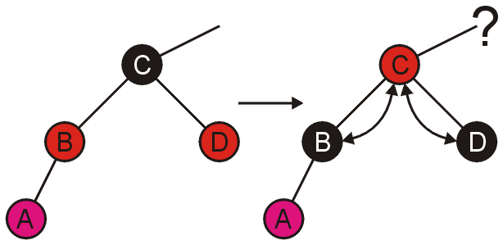
Insert with recoloring from bottom-up
In general, as we change the grandfather to red, we need to further check whether it violates the rule
So we need to do RB-INSERT-FIXUP on the grandfater

Slide 15
Insert with rotations
Try to insert 75
Its parent is red
What is the color of its uncle?
Black: NIL leaf node
Violate Rule 4
Let first try changing colors
27
2
50
70
75

Slide 16
Insert with rotations
Is the following RBT legal?
Rule 4 passes
Rule 5?
Path 27->50->NIL has less black nodes
We can not simply change colors in this case
27
2
50
70
75

Slide 17
Insert with rotations
Fixes up this case
Still want the parent to change color for Rule 4
Instead of only playing with colors let’s do rotation
27
2
50
70
75

Slide 18
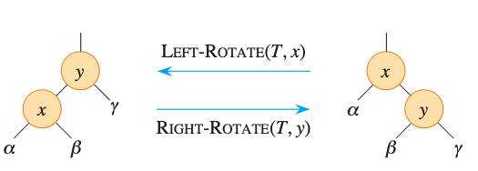
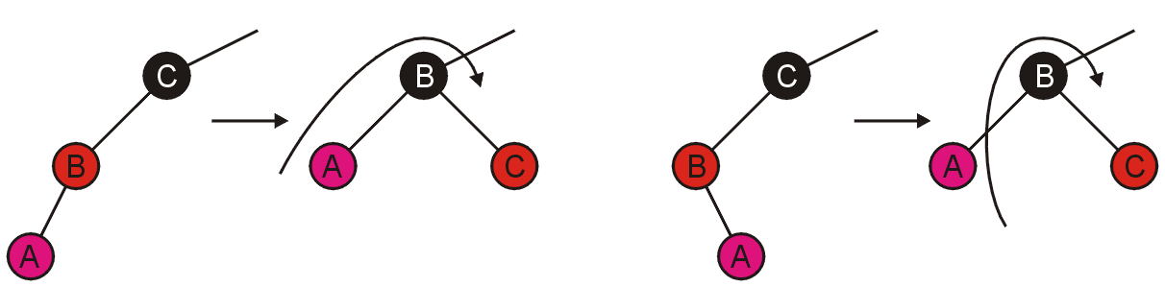
Insert with rotations
In this example, we can change the colors of z.p and z.p.p, then do a left-rotation
In general, which rotation to take is determined by the direction of trees
27
27
2
50
2
70
70
50
75
75

Slide 19
Shall we go to the next iteration for fixup?
In case 1, we need, because the node c is red and may be conflict with the previous ones
In the rotation case, we can end here, as it does not introduce new conflicts

Slide 20
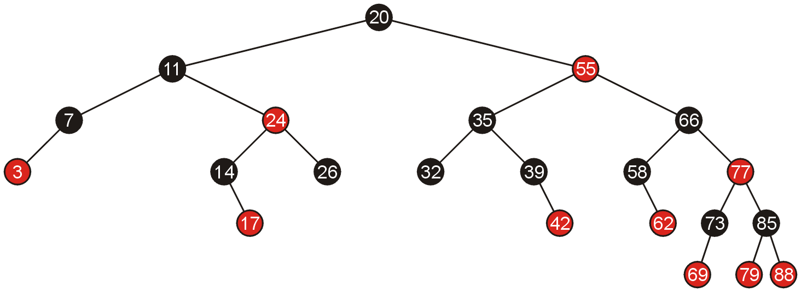
Examples of Insertions
Given the following red-black tree, we will make a number of insertions

Slide 21
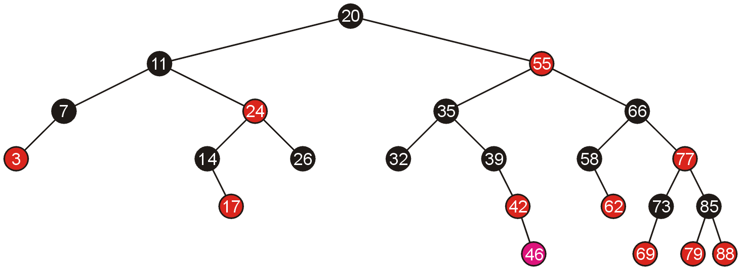
Examples of Insertions
Adding 46 creates a red-red pair which can be corrected with a single rotation

Slide 22
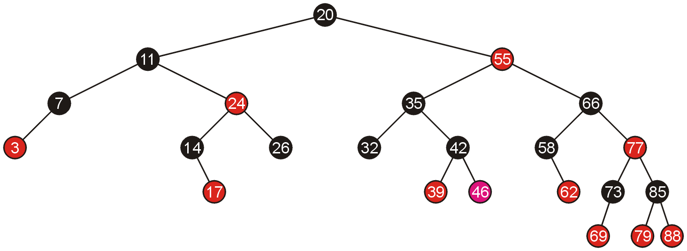
Examples of Insertions
Because the pivot is still black, we are finished

Slide 23
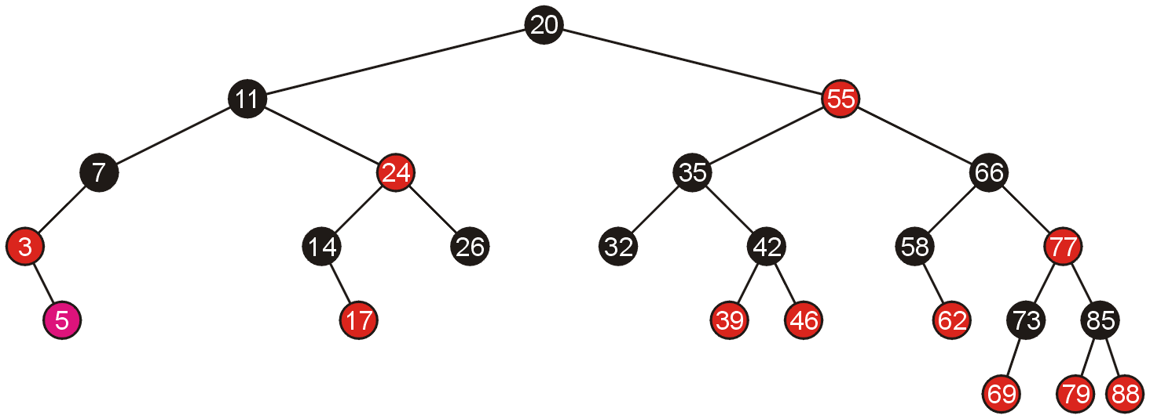
Examples of Insertions
Similarly, adding 5 requires a single rotation

Slide 24
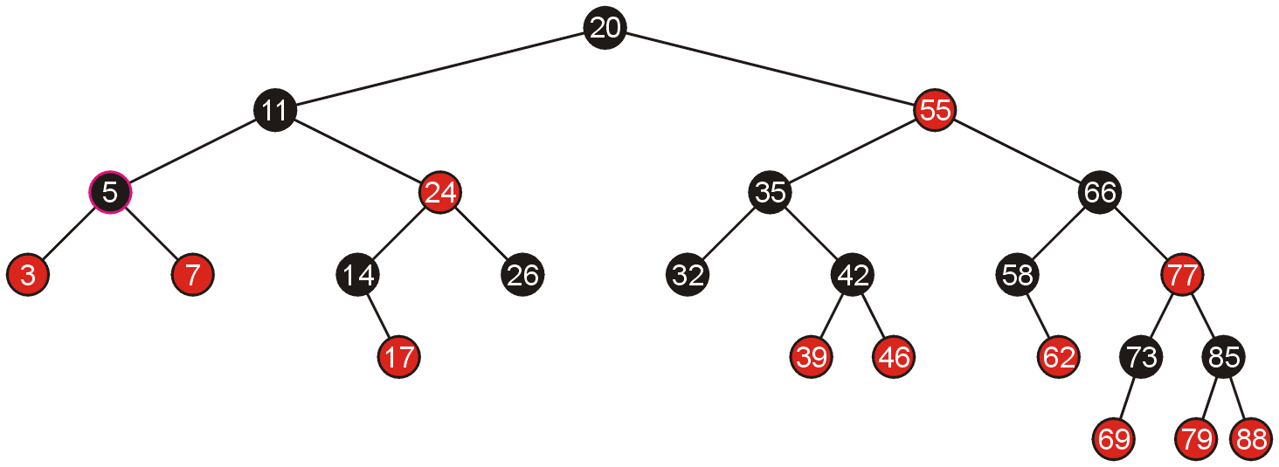
Examples of Insertions
Which again, does not require any additional work

Slide 25
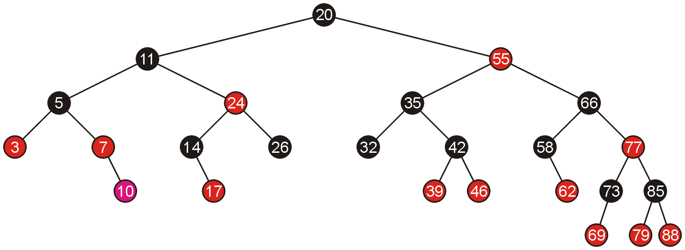
Examples of Insertions
Adding 10 allows us to simply swap the colour of the grand parent and the parent and the parent’s sibling

Slide 26
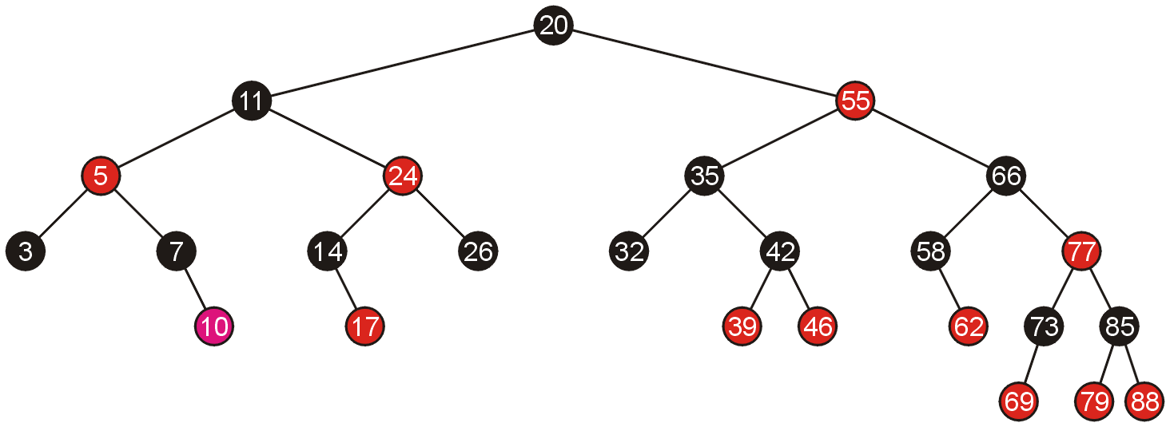
Examples of Insertions
Because the parent of 5 is black, we are finished

Slide 27
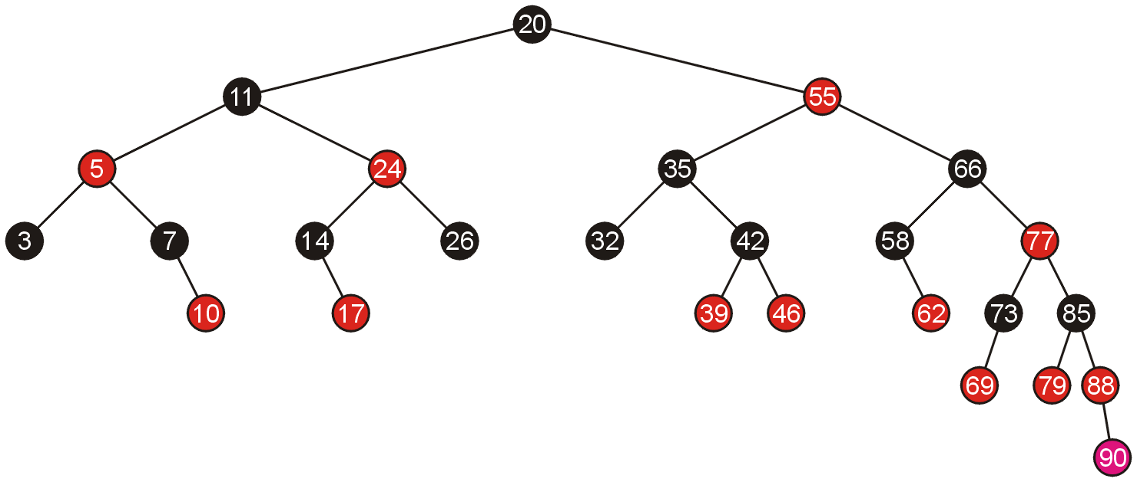
Examples of Insertions
Adding 90 again requires us to swap the colours of the grandparent and its two children

Slide 28
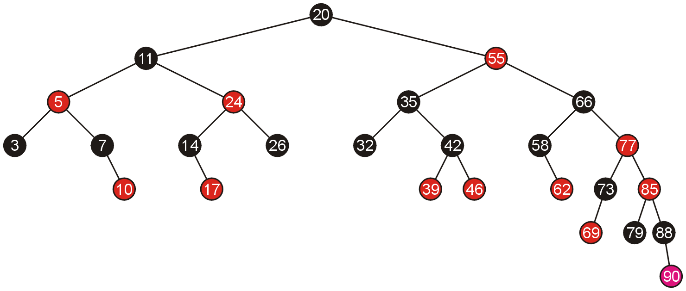
Examples of Insertions
This causes a red-red parent-child pair, which now requires a rotation

Slide 29
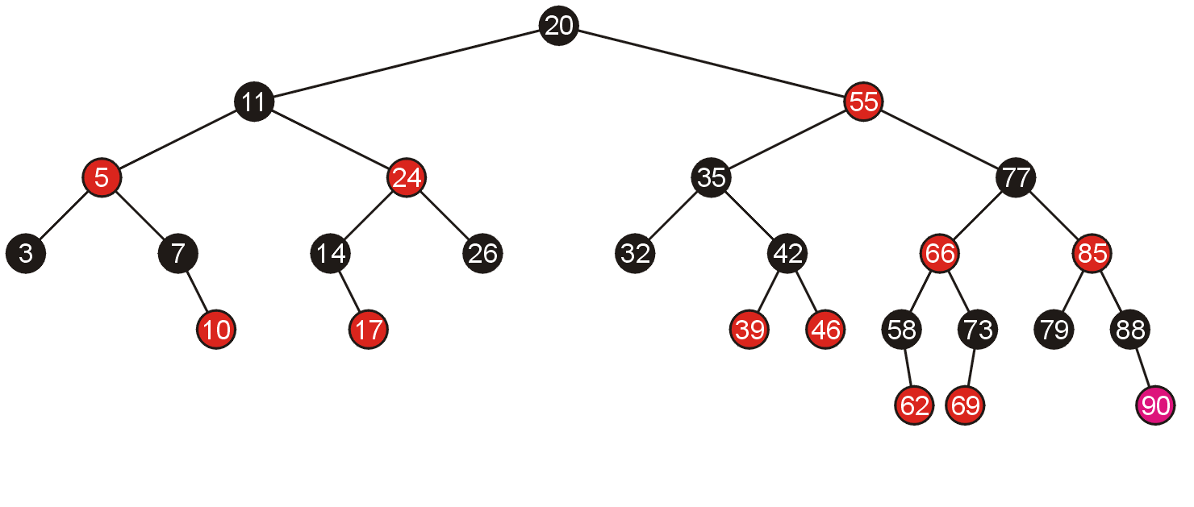
Examples of Insertions
A rotation does not require any subsequent modifications, so we are finished

Slide 30
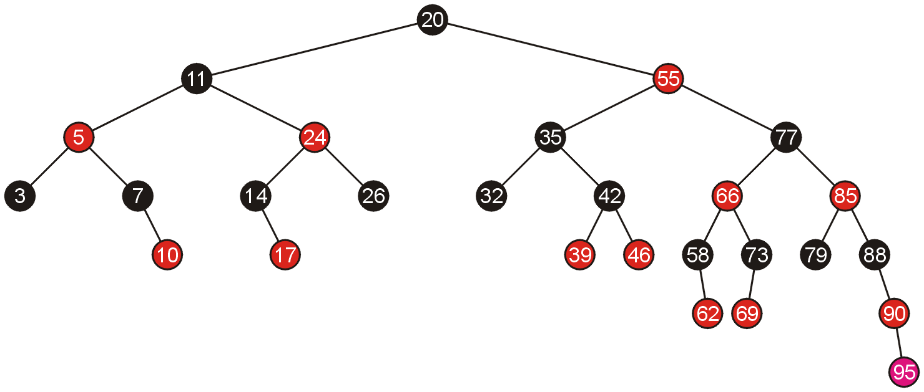
Examples of Insertions
Inserting 95 requires a single rotation

Slide 31
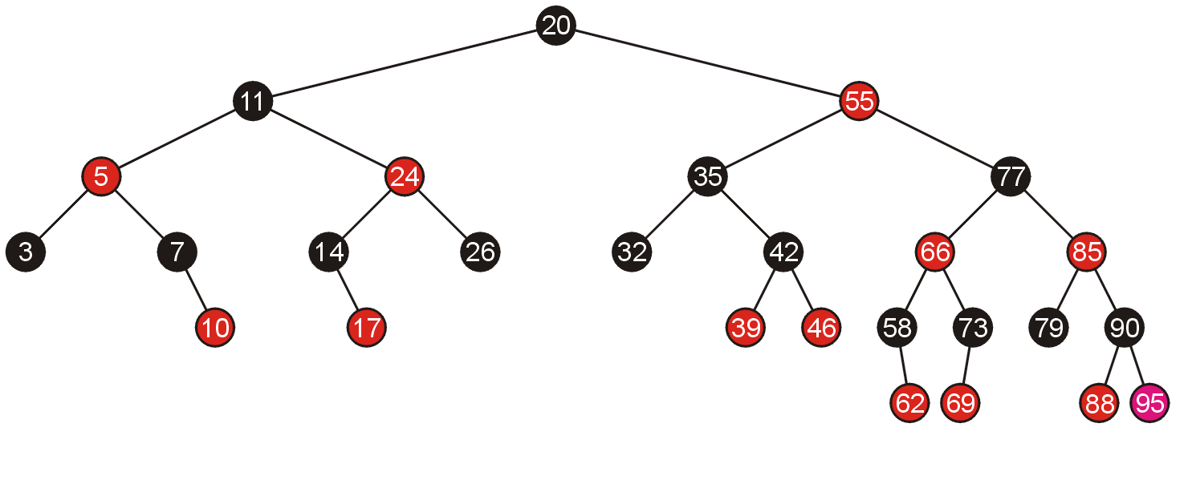
Examples of Insertions
And consequently, we are finished

Slide 32
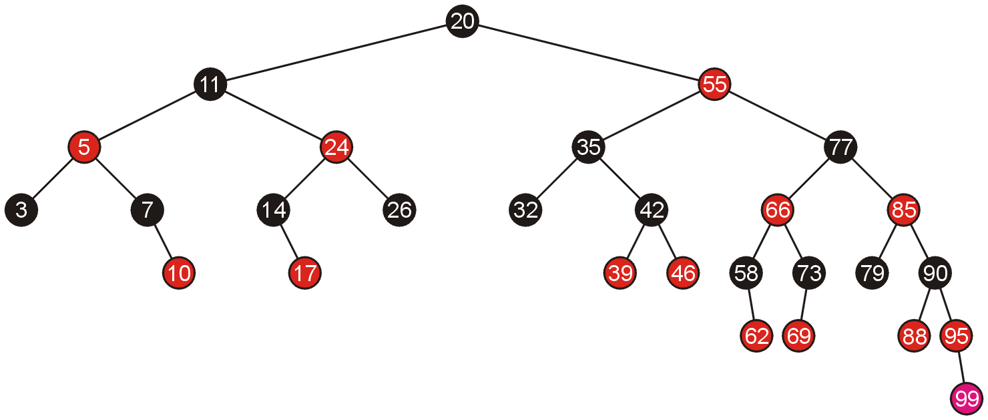
Examples of Insertions
Adding 99 requires us to swap the colours of its grandparent and the grandparent’s children

Slide 33
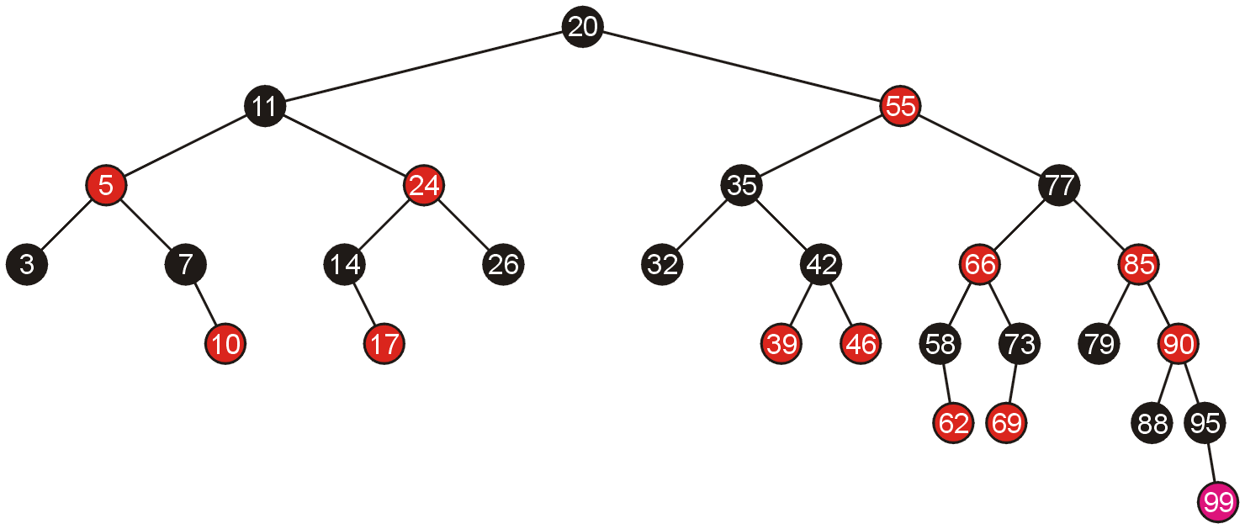
Examples of Insertions
This causes another red-red child-parent conflict between 85 and 90 which must be fixed, again by swapping colours

Slide 34
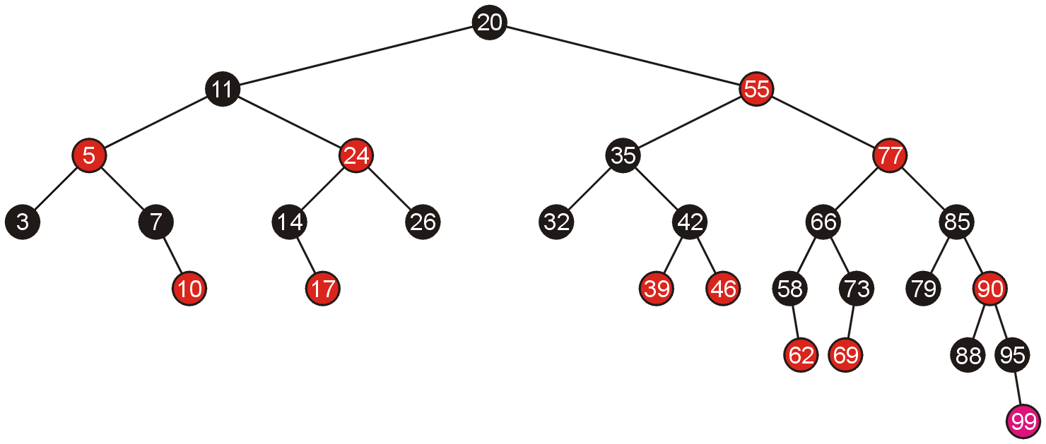
Examples of Insertions
This results in another red-red parent-child conflict, this time, requiring a rotation

Slide 35
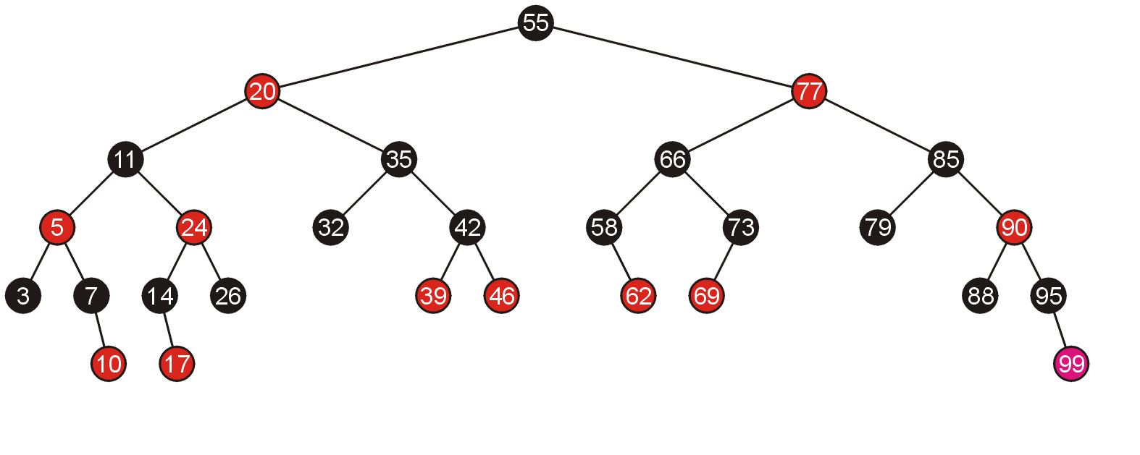
Examples of Insertions
Thus, the rotation solves the problem

Slide 36
Run time complexity of RB insert
What is the worst-case running time complexity?
The height of an RB tree is O(log n)
Our insert terminates after rotation case, where each rotation takes O(1) time
For the recoloring case, each time z moves two level up the tree. And the coloring operation takes O(1) time
RB tree insertion is O(log n)

Slide 37
RB delete
Deletion following the same ideology
Do a BST deletion first and then fixup the violations
In which case do we need to fixup?
In BST deletion, if z is leaf, we just delete it.
We can view as we replace z with a NIL in RBT
If z has one child in BST, we replace z with its child
We can view we replace z with its child in RBT
If z has two children, we find its successor, move it to z and do transplant
We can view we change the value of z to its successor and remove the successor

Slide 38
RB delete
In BST deletion, if z is leaf, we just delete it.
We can view as we replace z with a NIL in RBT
If z has one child in BST, we replace z with its child
We can view we replace z with its child in RBT
If z has two children, we find its successor, move it to z and clear the remaining
We can view we change the key of z to its successor and do transplant
In all the cases, the key change do not make difference
We need to find which cases raise problems in the coloring
We can just consider what is the color of the removed node

Slide 39
Consider only the black case
Rule 4: If a node is red, then both its children are black
Rule 5: For each node, all simple path from the node to descendant leaves contains the same number of black nodes
Observe the case, if we are removing a red node, do we need to change anything?
In BST deletion, if z is leaf, we just delete it.
We can view as we replace z with a NIL in RBT
No.

Slide 40
Consider only the black case
Rule 4: If a node is red, then both its children are black
Rule 5: For each node, all simple path from the node to descendant leaves contains the same number of black nodes
Observe the case, if we are removing a red node, do we need to change anything?
If z has one child in BST, we replace z with its child
We can view we replace z with its child in RBT
No. If z is red, it must either has two black children or two NIL leaves.

Slide 41
Consider only the black case
Rule 4: If a node is red, then both its children are black
Rule 5: For each node, all simple path from the node to descendant leaves contains the same number of black nodes
Observe the case, if we are removing a red node, do we need to change anything?
If z has two children, we find its successor, move it to z and transplant
We can view we change the key of z to its successor y and remove the y
No. y is successor so it at most has one child. But if y is red, it has to have two black children or two NIL.

Slide 42
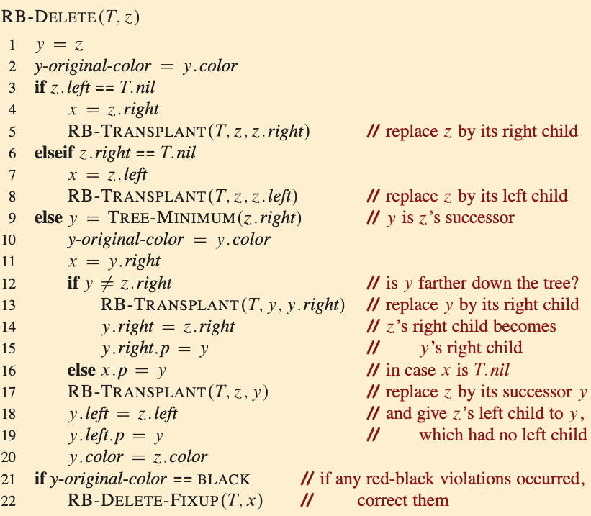
FIXUP on removing a black node
Think in the process we always ends up in replacing one node with another
Do FIXUP at the node taking the place if the removed one is black

Slide 43
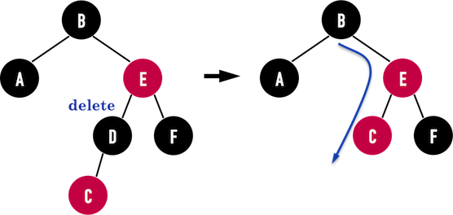
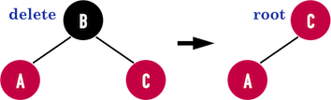
RB delete: possible errors
In general, if the node x is red, just change it black and we are done
Case 0
If node x is black, we need to solve case by case
We need to restore the original black height

Slide 44
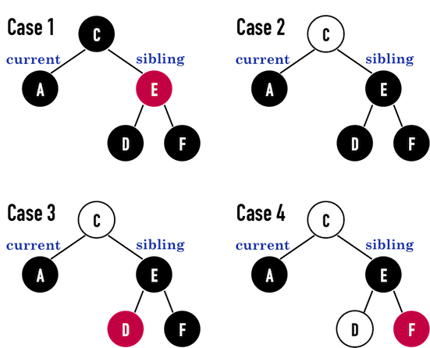
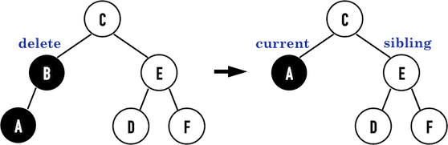
Four cases in FIXUP
If x is black, we have four cases depending on its sibling
White means its color does not matter

Slide 45
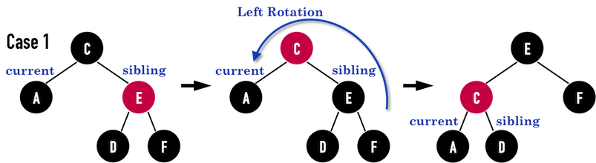
Case 1: x’s sibling is red
In this case, we haven’t fixed anything.
The problem is convert to the other cases

Slide 46
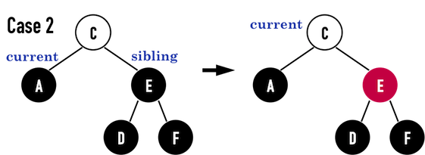
Case 2
x’s sibling w is black, and both of w’s children are black
w is colored red and the x now pointing to its original parent
We can do a FIXUP again

Slide 47
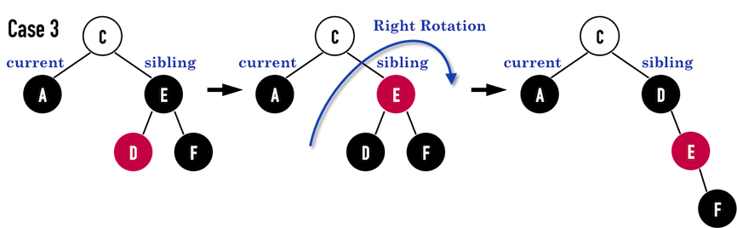
Case 3
x’s sibling w is black, w’s left child is red, w’s right child is black
Coloring D to black and E to red, then do a right rotation at E
The result of case 3 goes directly to case 4

Slide 48
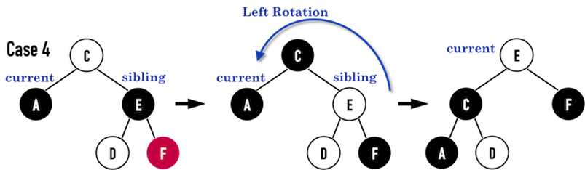
Case 4
x’s sibling w is black, w’s right child is red
Coloring E to the color of C
Coloring C to black
Then do a left rotation on C
We can do a FIXUP again

Slide 49
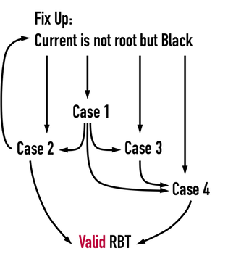
A loop between four cases
Case 1 and 3 will be transferred to case 2 or 4 in 1 or 2 steps
Case 2 and 4 will always move the current node upper by one level
The termination is O(log n)

Slide 50
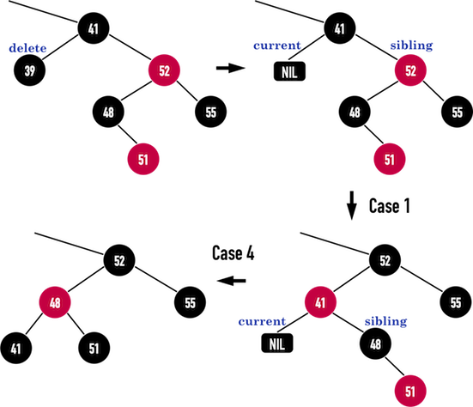
Example of FIXUP

